Slide 1
Xamarin.Forms Updates and Roadmap
Alejandro Ruiz
Microsoft MVP: Developer Technologies

Slide 2

Xamarin.Forms 4.0
Released on May
Introduced Xamarin.Forms Shell
Several bug fixes and community contributions.

Slide 3
Xamarin.Forms 4.1
MapClicked event added
Map with ItemTemplateSelector
CheckBox

Slide 4
Xamarin.Forms 4.2
ThumbColor for switch added
Shell Lifecycle
FontImage Markup Extension

Slide 5
Xamarin.Forms 4.3
CollectionView
RefreshView
HTML support for Labels

Slide 6
Xamarin.Forms Shell
Is a container for applications, that provides fundamental UI features that most applications require, leaving you to focus on the application's core workload.
Shell applications are provided with the following functionality:
A single place to describe the visual hierarchy of an application.
A common navigation user experience.
A URI-based navigation scheme that permits navigation to any page in the application.
An integrated search handler.

Slide 7
XAML Hot Reload for Xamarin.Forms 🔥🔃
XAML Hot Reload for Xamarin.Forms enables you to make changes to your XAML UI. Also see them reflected live, without requiring another compile and deploy.
Your application is compiled using XAML Hot Reload. Which means it works with all libraries and third-party controls. Whether you are building an iOS or Android app or iterating on an emulator, simulator, or physical device, XAML Hot Reload plugs into your existing workflow. This enables you to rapidly iterate over your user interface.

Slide 8
DEMO

Slide 9
Future Roadmap Xamarin.Forms
November/December 2019
CarouselView
Custom/Embedded fonts
Add "Target" support to VisualStateManager
IndicatorView(Cross and Native support)
SwipeView
Gradiants

Slide 10
Future Roadmap Xamarin.Forms
2020
MediaElement/MediaPlayer
CameraView
RadioButton
GIF Animation Support
Support Glide by Default for all Images
Floating Action Buttons
Transparent Navigation Bar
Shell V2(open Navigation API, Flyout Footer & Content, Top Tab & Bottom Template)
Segue & Transition API
Fluent API

Slide 11
Xamarin Hot Restart
XAML Hot Reload for Xamarin.Forms enables you to rapidly iterate on your XAML UIs at runtime without having to build and deploy. However, what about other types of changes? Such as C# code edits, adding resources, or multi-file edits?

Slide 12
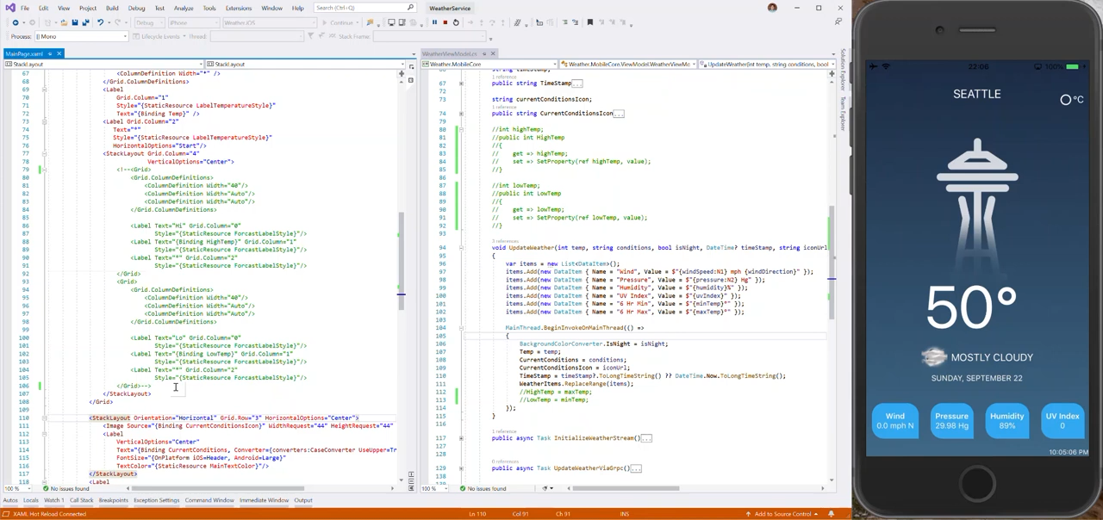

Slide 13
Sign up for Preview
http://bit.ly/HotRestartPreview

Slide 14
Resources
https://github.com/xamarin/Xamarin.Forms/wiki/Feature-Roadmap
https://docs.microsoft.com/en-us/xamarin/xamarin-forms/release-notes/
https://docs.microsoft.com/en-us/xamarin/xamarin-forms/app-fundamentals/shell/

Slide 15
Questions?
Alejandro Ruiz Varela
Microsoft MVP: Developer Technologies
Xamarin.Forms updates and roadmap
alejandro@alejandroruizvarela.com
@alejandroruizva
alejandroruizvarela.blogspot.com
DEMO: https://github.com/AlejandroRuiz/UnoTalks2019

